Slide 1
Web and mobile app development – csc3054/7054
9.1 Smartphone web development

Slide 2
Leo Grand – an app programmer
Used to work at MetLife.
Was offered the choice between $100 or coding lessons by Patrick McConlogue.
Leo chose to learn coding and developed his own mobile app, “Trees for cars”.
Less than a year, he earned around $10,000 for his app that went on sale for only $0.99 per download.

Slide 3
What did we discuss in the last lecture?
What is “mobile web”?
Why develop “mobile web”?
HTML and XHTML
Development environment set-up
Syntax of mobile web

Slide 4
Learning outcomes
To use HTML to create links and access keys.
To understand CSS and its role.
To use WML to create on-line applications.

Slide 5
Content outline
Links and access keys
CSS for mobile devices
Wireless markup language (WML)
Summary
Next lecture
Further readings

Slide 6
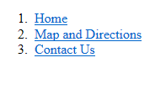
Links and access keys
There are links and access keys in the following example:

Slide 7
Links and access keys
For example,

Slide 8
Xhtml-mp code
<?xml version="1.0" encoding="UTF-8"?>
<!DOCTYPE html PUBLIC "-//WAPFORUM//DTD XHTML Mobile 1.0//EN" "http://www.wapforum.org/DTD/xhtml-mobile10.dtd">
<html xmlns="http://www.w3.org/1999/xhtml">
<head>
<link rel="stylesheet" href="/learnto.css" type="text/css" />
<title>XHTML-MP Access Keys</title>
</head>
<body>
<ol>
<li><a href="/" accesskey="1">Home</a></li>
<li><a href="/map.php" accesskey="2">Map and Directions</a></li>
<li><a href="/contact.php" accesskey="3">Contact Us</a></li>
</ol>
</body>
</html>

Slide 9
Xhtml-mp code
<ol>
<li><a href="/" accesskey="1">Home</a></li>
<li><a href="/map.php" accesskey="2">Map and Directions</a></li>
<li><a href="/contact.php" accesskey="3">Contact Us</a></li>
</ol>
Access keys combined with ordered list (<ol> and <li> tags): <ol> refers to numbers and <li> wraps texts

Slide 10
Content outline
Links and access keys
CSS for mobile devices
Wireless markup language (WML)
Summary
Next lecture
Further readings

Slide 11
CSS for mobile devices
What is CSS?
  Cascading Style Sheet (CSS).
  From wikipedia: “A style sheet language used for describing the presentation semantics (look/format) of a document written in a markup language”.
<head>
<link rel="stylesheet" href="/learnto.css" type="text/css" />
<title>XHTML-MP Access Keys</title>
</head>

Slide 12
CSS for mobile devices
Why do we need CSS?
  Separation of content from presentation.
  Site-wide styling consistency.
  Bandwidth.
  Page reformatting.
  Accessibility (HTML tables).
Site-wide: The linking and navigation structure deployed across an entire web site.

Slide 13
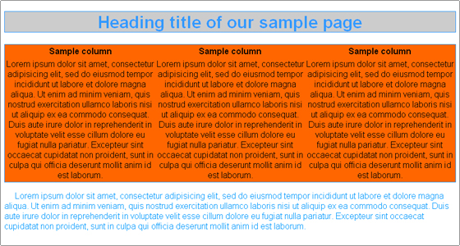
A simple example of CSS
body { font-family: arial; }h1 { background-color:#CCC; border: 1px solid; color:#39F; text-align: center; }table { background-color: #F60; border: 1px solid #39F; width: 100%; }td { border: 0px; text-align: center; }p { color:#09F; text-indent: 20px; }

Slide 14
Content outline
Links and access keys
CSS for mobile devices
Wireless markup language (WML)
Summary
Next lecture
Further readings

Slide 15
Wireless markup language (WML)
What is WML?
  An XML-based markup language for mobile devices.
  Predating XHTML-MP.
  Less used for new Mobile Web projects.
  A WML document is known as a “deck”.

Slide 16
Tag hierarchy
Starts from the root tag <wml>.
Child tags of <wml>:
  <head>: metadata and access control.
  <card>: a card to display in the browser:
    Basic units of WML.
    Several cards to form a deck.
  <template>: event handles and commands for the deck.
Metadata: it is data that describes other data, and summarises
basic information about data to make it is easier to find and work
with data.

Slide 17
Header and metadata
A WML document consists of a header – stores document metadata and access control.
Document metadata – defined using the <meta> tag, formatted using “name” and “content” attributes.
<access> tag – to restrict the data access by domain and path URL (uniform resource locator) components.

Slide 18
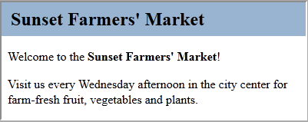
Example display…
Use of Mozilla Firefox. 2. To install add-ons for viewing WML on Firefox: https://addons.mozilla.org/en-US/firefox/addon/wmlbrowser/?src=cb-dl-mostpopular

Slide 19
Wml code
<?xml version="1.0" encoding="utf-8"?>
<!DOCTYPE wml PUBLIC "-//WAPFORUM//DTD WML 1.3//EN" "http://www.wapforum.org/DTD/wml13.dtd">
<wml>
<head>
<meta http-equiv="Cache-Control" content="no-cache" />
<meta name="Author" content="Gail Rahn Frederick" />
<access domain="learnto.mobi" />
</head>
<card id="start" title="Sunset Farmers&apos; Market">
<p>Welcome to the <b>Sunset Farmers&apos; Market</b>!</p>
<p>Visit us every Wednesday afternoon in the city center for farm-fresh fruit, vegetables and plants.
</p>
</card>
</wml>

Slide 20
hyperLinks: three tags
<a> tag – Specifies the link location in the href attribute (hypertext reference).
<a href=http://learnto.mobi/books/bmwd/03/3-5.wml>Listing 3-5</a>
<anchor> tag – Creates hyperlinks in WML documents.
<anchor title-“txt”>label task</anchor>
<do> tag – Creates links in WML
<do type=“type” label=“label” name=“name” optional=“optional”> task img</do>

Slide 21
Images
<img> tag embeds an image into a WML document.
  “src” attribute specifies the image URL.
  “width” and “height” attributes set the image dimensions.
  “align” attribute aligns the image to the text line, which has values as top, middle or bottom.

Slide 22
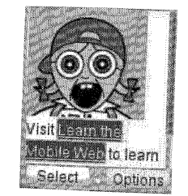
Image to be displayed…

Slide 23
wml code
<?xml version="1.0" encoding="utf-8"?>
<!DOCTYPE wml PUBLIC "-//WAPFORUM//DTD WML 1.3//EN" "http://www.wapforum.org/DTD/wml13.dtd">
<wml>
<card id="image" title="WML Images">
<p><img src="http://learnto.mobi/img/screamer_icon.png" width="96" height="88" alt="Screaming Geek" align="bottom"/> Visit <a href="http://learnto.mobi">Learn the Mobile Web</a> to learn about mobile web development.</p>
</card>
</wml>

Slide 24
Tables
WML supports primitive tables to display data in a grid format.
<table> tag has single attribute columns, which define the column number in the table.

Slide 25
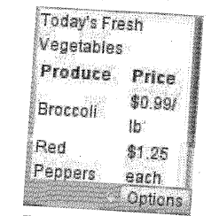
To show…

Slide 26
wml code
<?xml version="1.0" encoding="utf-8"?>
<!DOCTYPE wml PUBLIC "-//WAPFORUM//DTD WML 1.3//EN"
"http://www.wapforum.org/DTD/wml13.dtd">
<wml>
<!-- NOTE: WML browsers take liberties with cell alignment in table rendering!-->
<card id="text" title="WML Tables">
<p>Today&apos;s Fresh Vegetables</p>
<p> <table title="Title" columns="2">
<tr>
<td><b>Produce</b></td>
<td><b>Price</b></td>
</tr>
<tr>

Slide 27
wml code
<td>Broccoli</td>
<td>$$0.99/lb</td>
</tr>
<tr>
<td>Red Peppers</td>
<td>$$1.25 each</td>
</tr>
<tr>
<td>Jerusalem Artichokes</td>
<td>$$1.00 each</td>
</tr>
</table> </p>
</card>
</wml>

Slide 28
Timers
<timer> tag that waits 5 seconds before expiring:
<timer value=“50”/>
ontimer event: navigates to any URL, e.g. external cards and documents:
  <card id=“timer” title=“Welcome” ontimer=http://leanrto.mobi/books/bmwd/03/3-7.wml#expired>

Slide 29
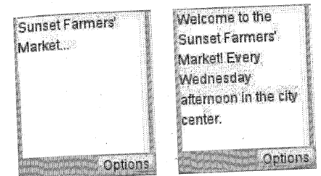
To display…
WML Timers: Before and after expiration

Slide 30
wml code
<?xml version="1.0" encoding="utf-8"?>
<!DOCTYPE wml PUBLIC "-//WAPFORUM//DTD WML 1.3//EN"
"http://www.wapforum.org/DTD/wml13.dtd">
<wml>
<card id="timer" title="Welcome" ontimer="#next">
<timer value="50" />
<p>Sunset Farmers&apos; Market...</p>
</card>
<card id="next" title="Sunset Market">
<p>Welcome to the Sunset Farmers&apos; Market! Every Wednesday afternoon in the city center.</p>
</card>
</wml>

Slide 31
Content outline
Links and access keys
CSS for mobile devices
Wireless markup language (WML)
Summary
Next lecture
Further readings

Slide 32
Summary
Introduced concepts of links and access keys.
Presented CSS basics.
Used WML scripts to implement some examples.

Slide 33
Content outline
Links and access keys
CSS for mobile devices
Wireless markup language (WML)
Summary
Next lecture
Further readings

Slide 34
next lecture
To introduce a server-client communication app using PHP (we will learn some PHP basics first).

Slide 35
Content outline
Links and access keys
CSS for mobile devices
Wireless markup language (WML)
Summary
Next lecture
Further readings

Slide 36
Further readings
Beginning Smartphone Web Development: Building JavaScript, CSS, HTML and Ajax-based Applications for iPhone, Android, Palm Pre, BlackBerry, Windows Mobile and Nokia S60. Gail Frederick. Publisher: Apress; 1 edition (January 15, 2010).

